Slide 1
Don’t know where
Don’t know when
We’ll meet again

Slide 3
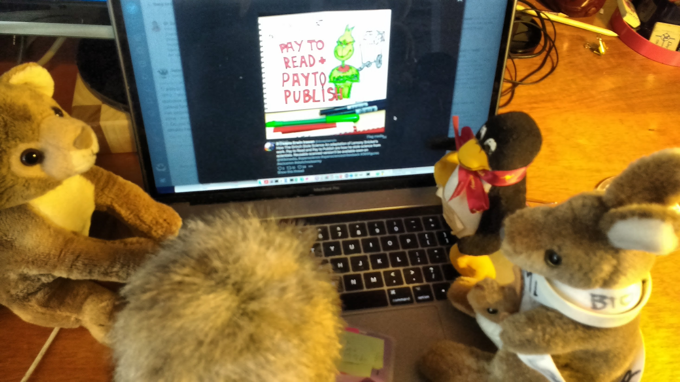
We’ve found some exciting cartoons!
From Dasapta Erwin,
How do you “steal science”? Doesn’t it belong to everyone?
They’re about the Grinch stealing science

Slide 4
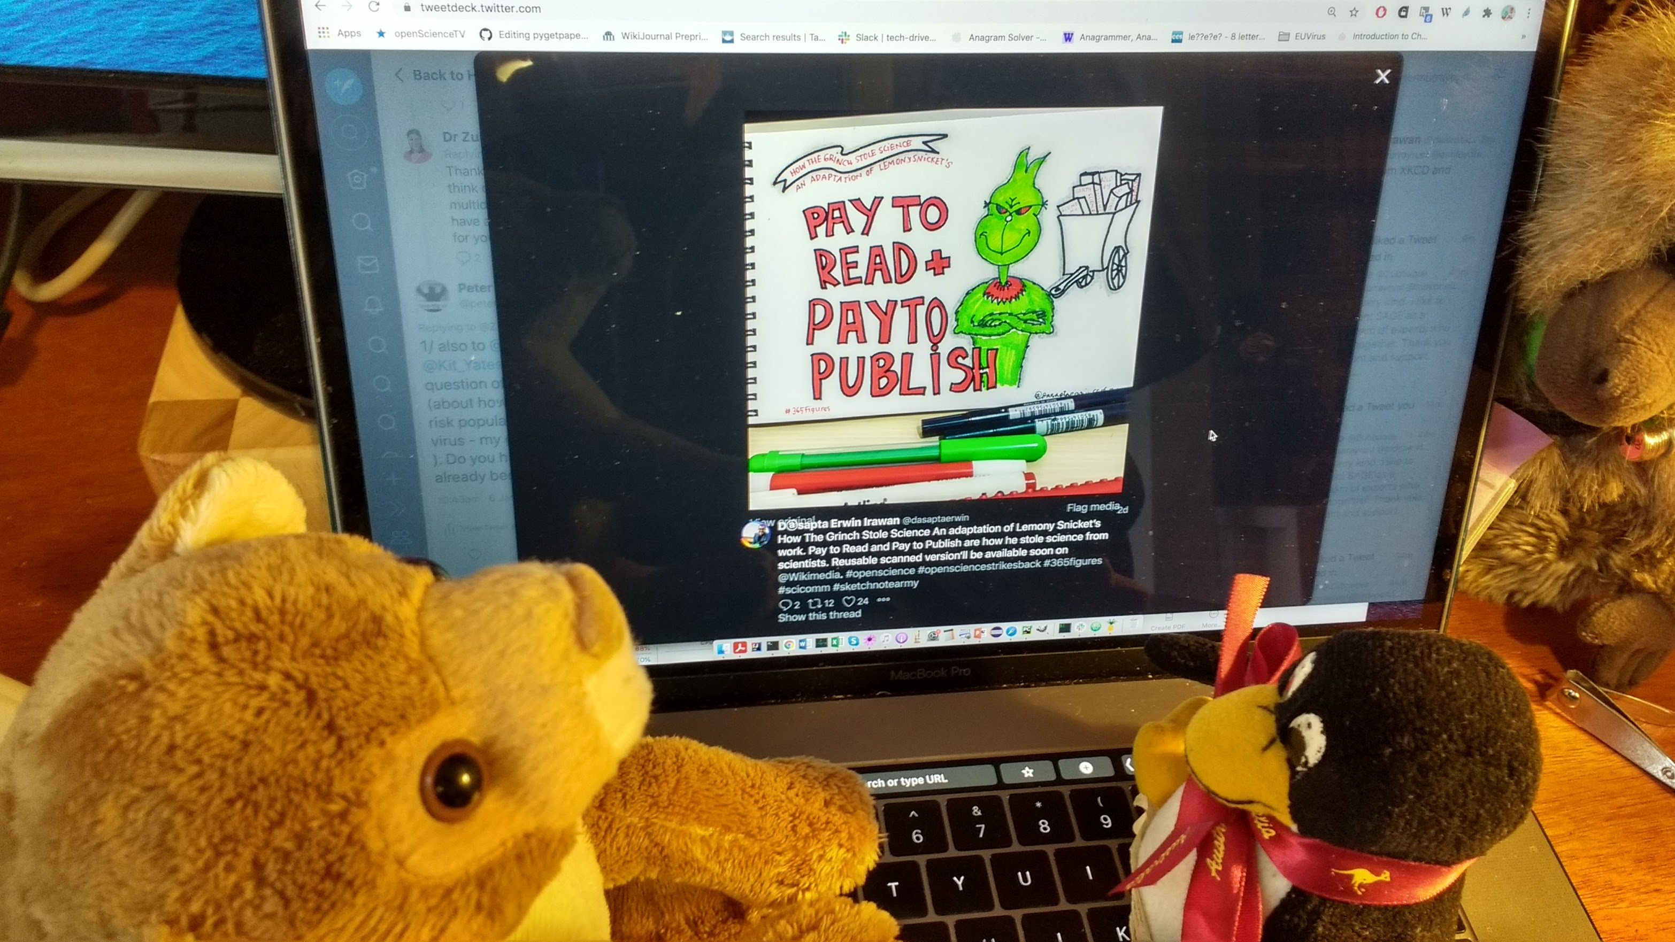
Dasapta @dasaptaerwin has lots of cartoons. He does one every day.
Wow! I’ll be looking for Grinch cartoons. I don’t think I like the Grinch

Slide 5
U A V C N H T B P S B Y A C J
T I C C F D T M A O X H G P A
O S N B A L E H D R H U G Q O
B U W L D T L Q U A N I E O C
C S L E B A B K T B R E R E F
D E G Q P Y A K R R G D S O D
N G C Z I P J E S T U H P A A
N H O N P B A E B W K O L T V
K O Q X O I L E R U A I C O H
T U R X T X D V U Q S B S A V
N K S A H L R X S S B N Z J M
L V J I B P I L O A O F T N F
T V M D T U D N B L W G V I C
G W N F G H G K A I V B S Q M
Q T N B E P E * A L M E R A S

Slide 6
E A B E T T Y S I D V D
Z B O R A Q U M X O I N
R H O S E L B M A H S Y
T G T S M I N S T E R A
N M H O O F R Q K R I E
W W A F N F M I E L Z B
O W M T K O V T S A O T
R E G X Z R T Q Q D Q O
D S R T O D V F Y N H C
H I B J K U E T I E V D
Z M L E F W S I Q L Q L
L A V F K O C E A E C X

Slide 7
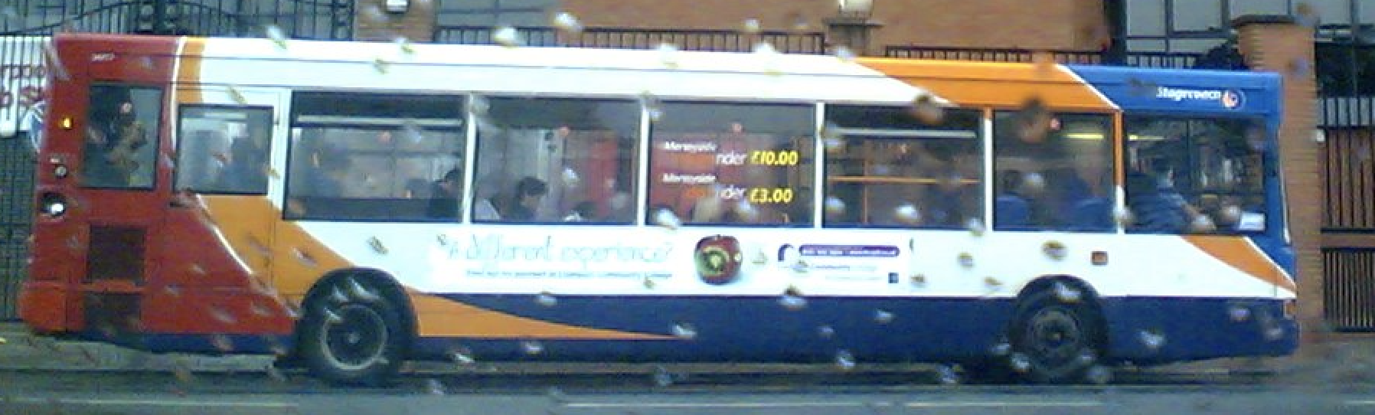
K J G W Y E L D A R B W I P S
N C I N O S N I B O R V E O I
C I K O Z H G R P B A Z Z L P
H Y Z Q W O O L E E Y F H N W
E R Y W N W L C R R B N S U K
W R J D F A D A K T O L Y D Z
I A K Z M H I B I S U T R E Y
T P L V T S E W N O L A S K J
T S N K B D M I S N D V S W X
O N N E E A K C T D N E B W J
Q E C Z O R Q T O N K K O K Y
E K H G A B L G V X F F S Z E
G A X P H R R Z S X U U B A K
L W O C N L D K Y B W F N Q N
S C S U I C M Y K V T O P J A

Slide 8
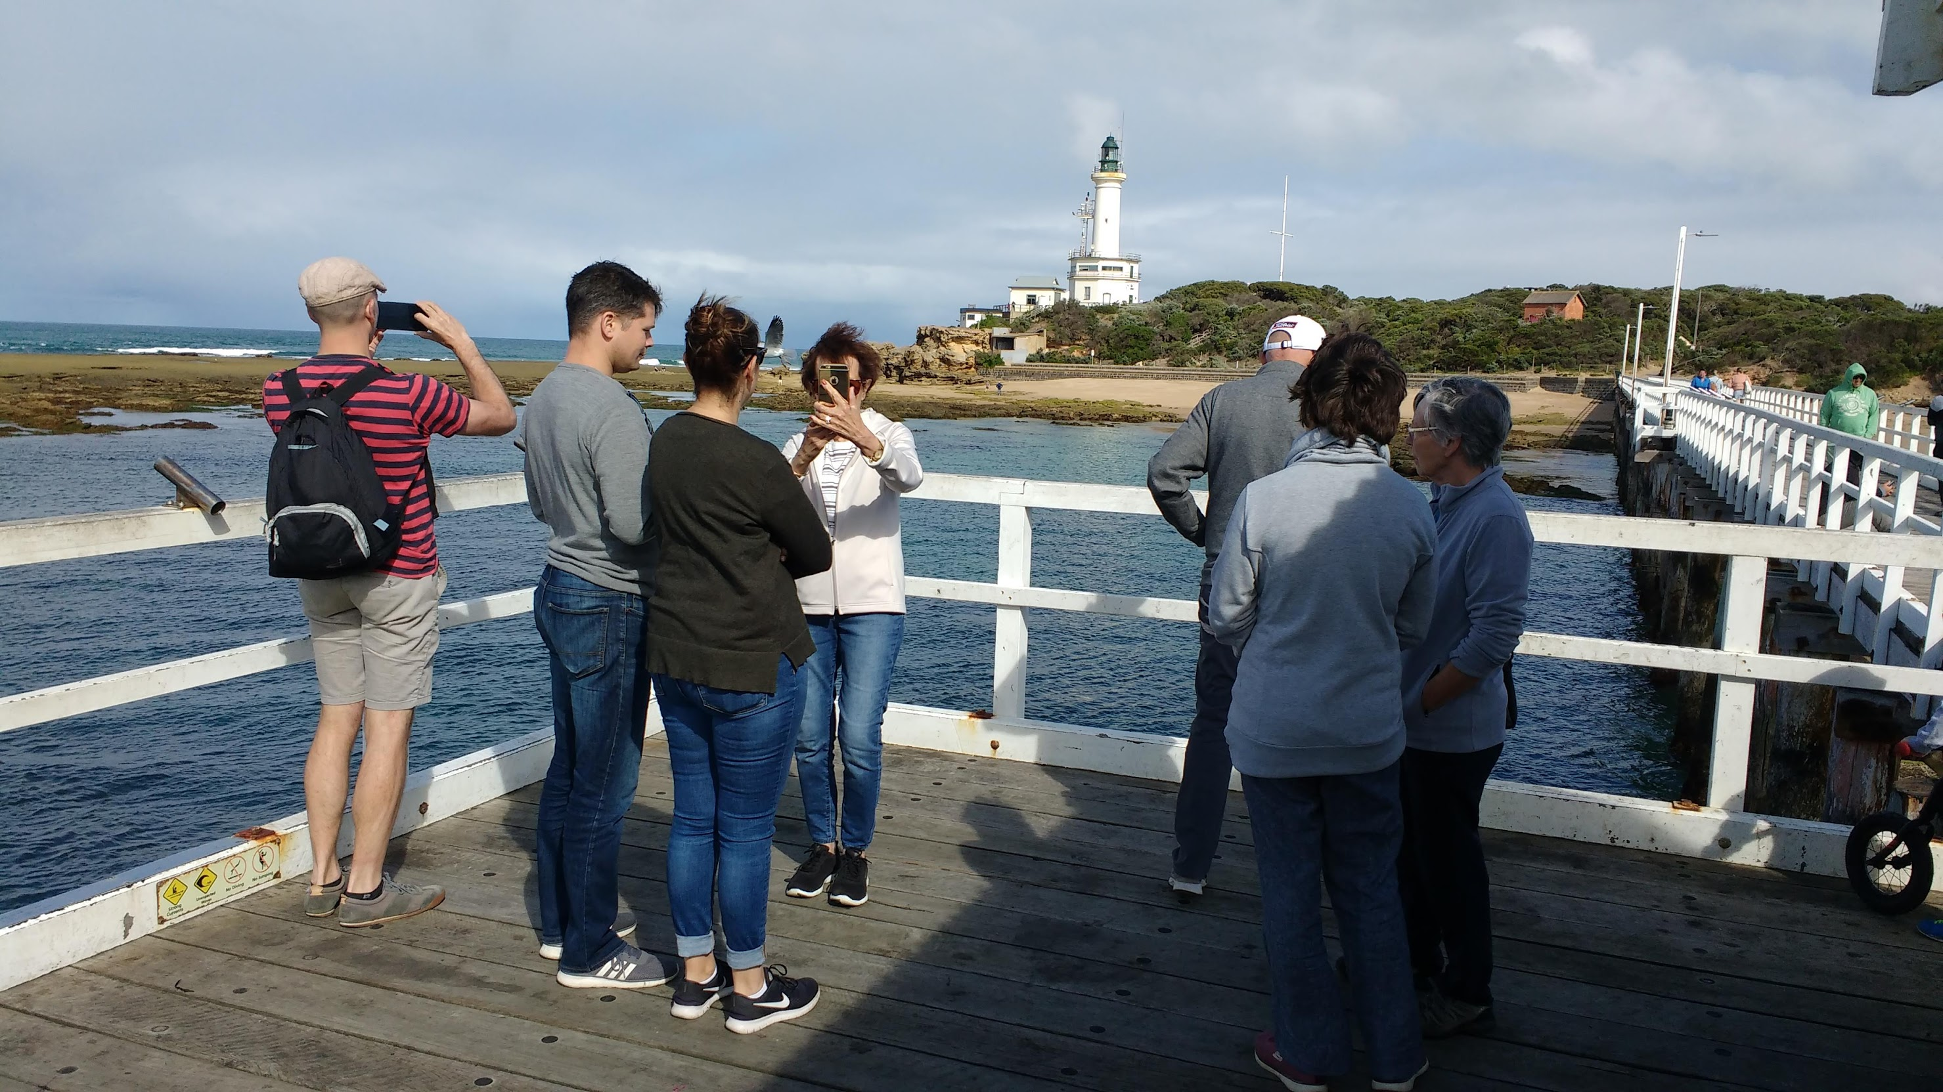
I T K V B M H G G I M H W X N
Z E A C F S Z A T L U L R T W
N E N O A A O L A D A W T T B
W K G Q V S P A B I J F S R M
F I A V K Y S H M T O C O L Q
A R R U B A K O O K Q L S I B
I O O H B M M N W A G S H Q M
R L O G O U E E A A R U M J R
Y P Y U M O V Y I K R P R Y H
W I E R Y O T E B P F Y A M D
R X N N E K U A D A G T N Y R
E M P K G B Q T K N L A Y X T
N H V M V U I E H C B L M X K
P B D F A N I R T P O P A F E
G P E L I C A N D I H C E W U

Slide 9
P I Y E U G A H P A M W J F M
O H S Q N L N L A D E R B E E
I L P H E S H V M O H X S O M
X S B I U A C T S E N D B K M
Q U D N A G E H T V R R H R T
B E N R O O D L E P A E W X L
N E L L O W Z D R D N U L H P
W E P G B T W Z D U E C T J V
M L V X Y E T M A U N F H I Q
T R O O F S R E M A Z V C O U
J N E H H E L W R Z N S E Z W
L E K Q J D H W A D A S R W N
V N E G N I N O R G A H T G D
G P G R U B L I T X P M U A W
H S N I J M E G E N Y S D A D
P I Y E U G A H P A M W J F M
O H S Q N L N L A D E R B E E
I L P H E S H V M O H X S O M
X S B I U A C T S E N D B K M
Q U D N A G E H T V R R H R T
B E N R O O D L E P A E W X L
N E L L O W Z D R D N U L H P
W E P G B T W Z D U E C T J V
M L V X Y E T M A U N F H I Q
T R O O F S R E M A Z V C O U
J N E H H E L W R Z N S E Z W
L E K Q J D H W A D A S R W N
V N E G N I N O R G A H T G D
G P G R U B L I T X P M U A W
H S N I J M E G E N Y S D A D

Slide 10
O H N W K Z W W N I X S J I S
B C P N B H Y Z X Q J J B E Y
S Z S H U Q L E B E V E S M E
I T V P Y P L D W I E N G P E
K A W I L L O W C C R I S L C
B B U N G B H P H F K C P I L
I X X E L Z A E L E Z A H M M
G N F A Q Q S Y C A M O R E E
D H Q J M T B N Q U R C C V M
J Y M I N Y F V Z N R C A Y E
S V X U I B K N B P I P H S O
U C T E T P K E Q D E F S O I
Z X K D L P A Y R E D Q A X X
X R G X C M O W L Z X G Y Z V
B F L Z H M S C N Q I J O F P
O H N W K Z W W N I X S J I S
B C P N B H Y Z X Q J J B E Y
S Z S H U Q L E B E V E S M E
I T V P Y P L D W I E N G P E
K A W I L L O W C C R I S L C
B B U N G B H P H F K C P I L
I X X E L Z A E L E Z A H M M
G N F A Q Q S Y C A M O R E E
D H Q J M T B N Q U R C C V M
J Y M I N Y F V Z N R C A Y E
S V X U I B K N B P I P H S O
U C T E T P K E Q D E F S O I
Z X K D L P A Y R E D Q A X X
X R G X C M O W L Z X G Y Z V
B F L Z H M S C N Q I J O F P

Slide 11
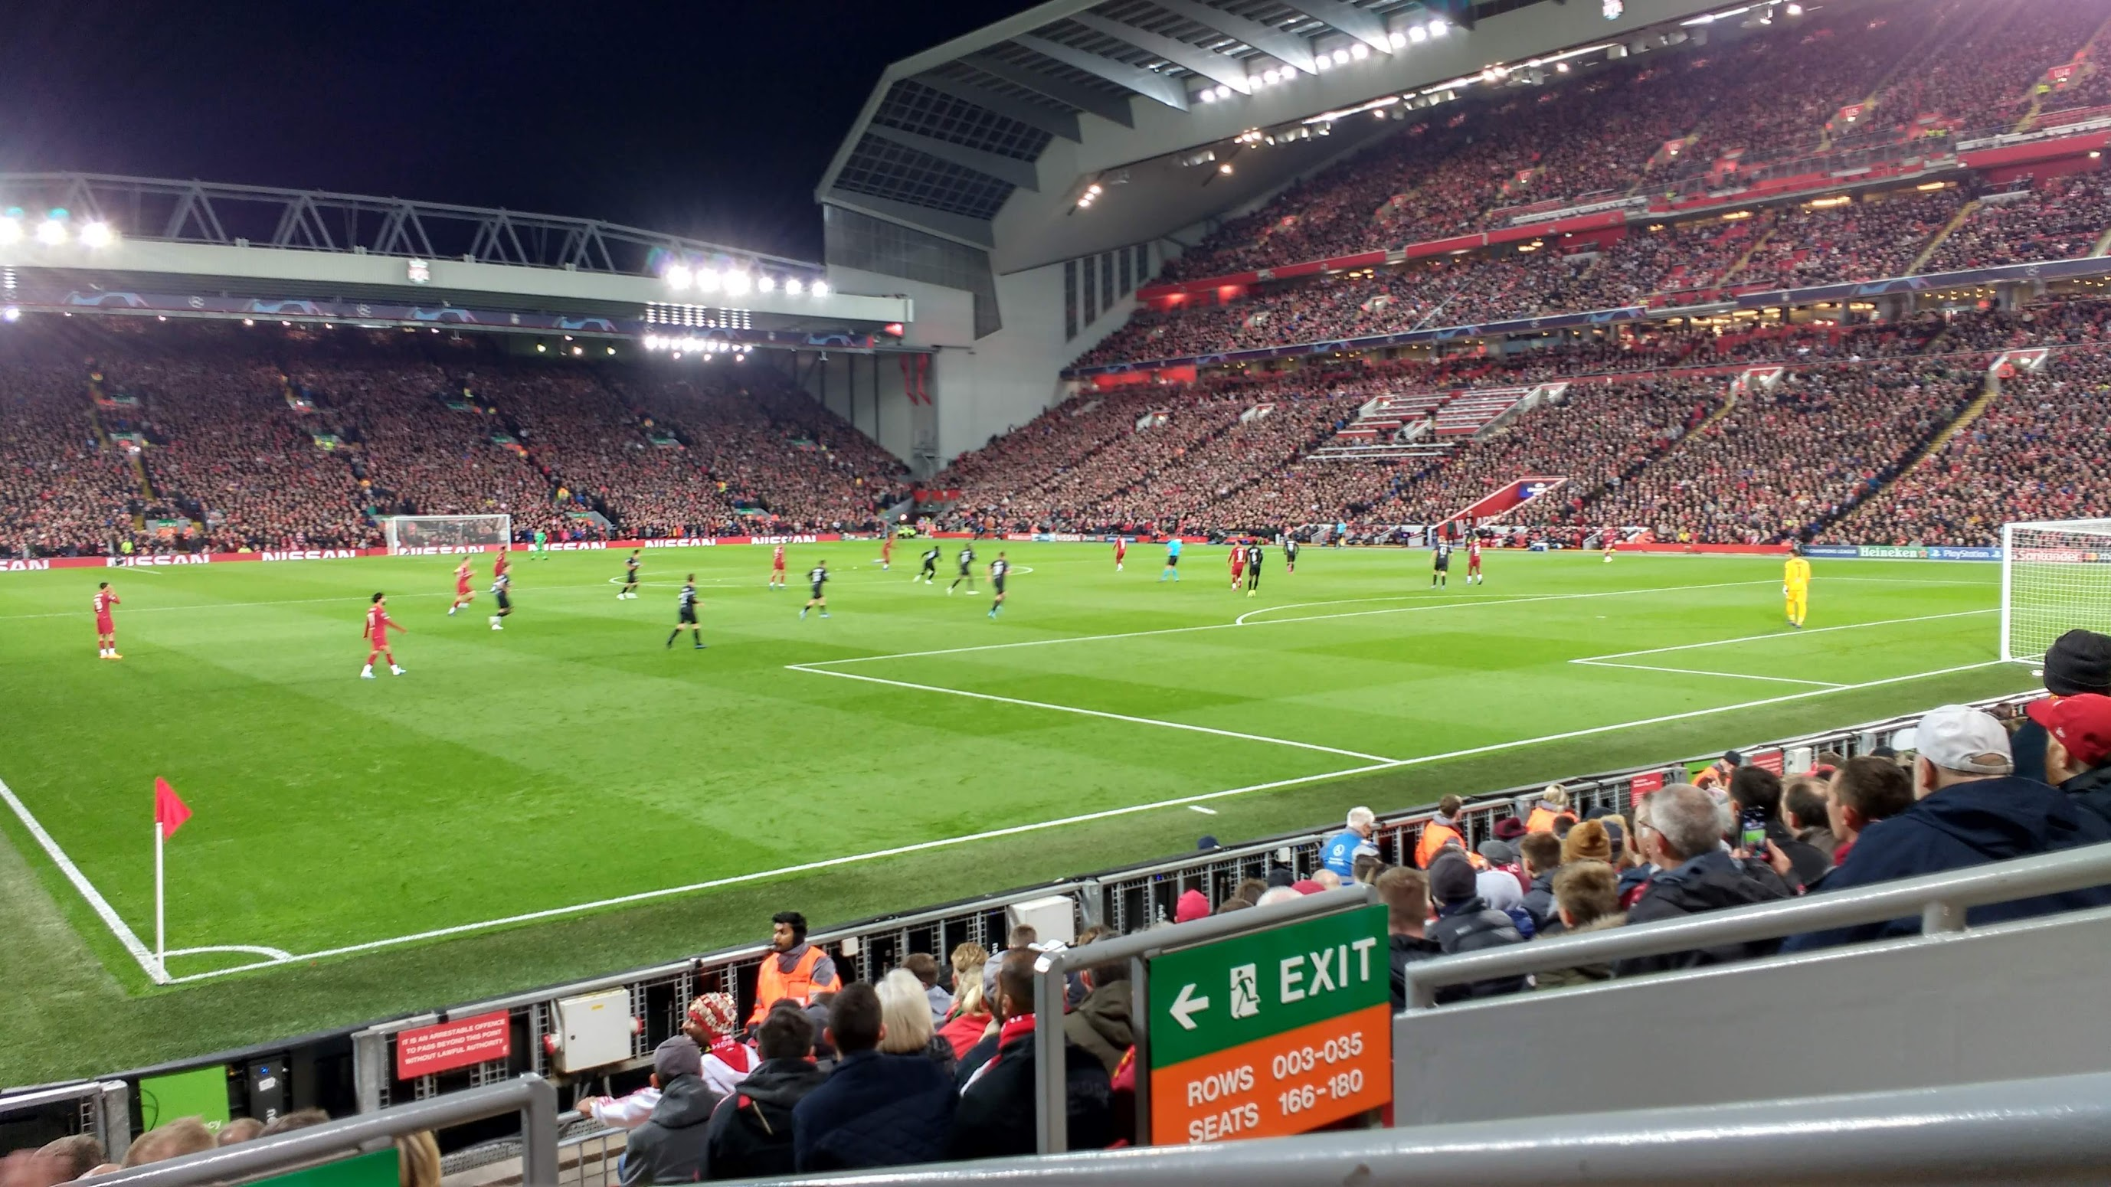
F N O H H N M N T K Y Y K A S
U A K O U X G N Y E J X I Z G
E H I D Z G F A E N K I E F C
Y G H R F E H L A A Q K V M D
Z A F H C N T E T J L O T X Y
C L W P T L T H S I L G L A D
K L Y H O I O W A X E S S J E
V A E A G M M U S J X D N G N
Z C I M P I R S G O W R A H N
H A N S E N E Z E H H C V K E
F G O R R N D H Y N A G E E K
A N T E U K C A H S O T N N U
X V O O H B M E E O W J B E P
W N S B S K L B J N O Q T Y J
Y A T K U S D E D A H P J X G

Slide 12
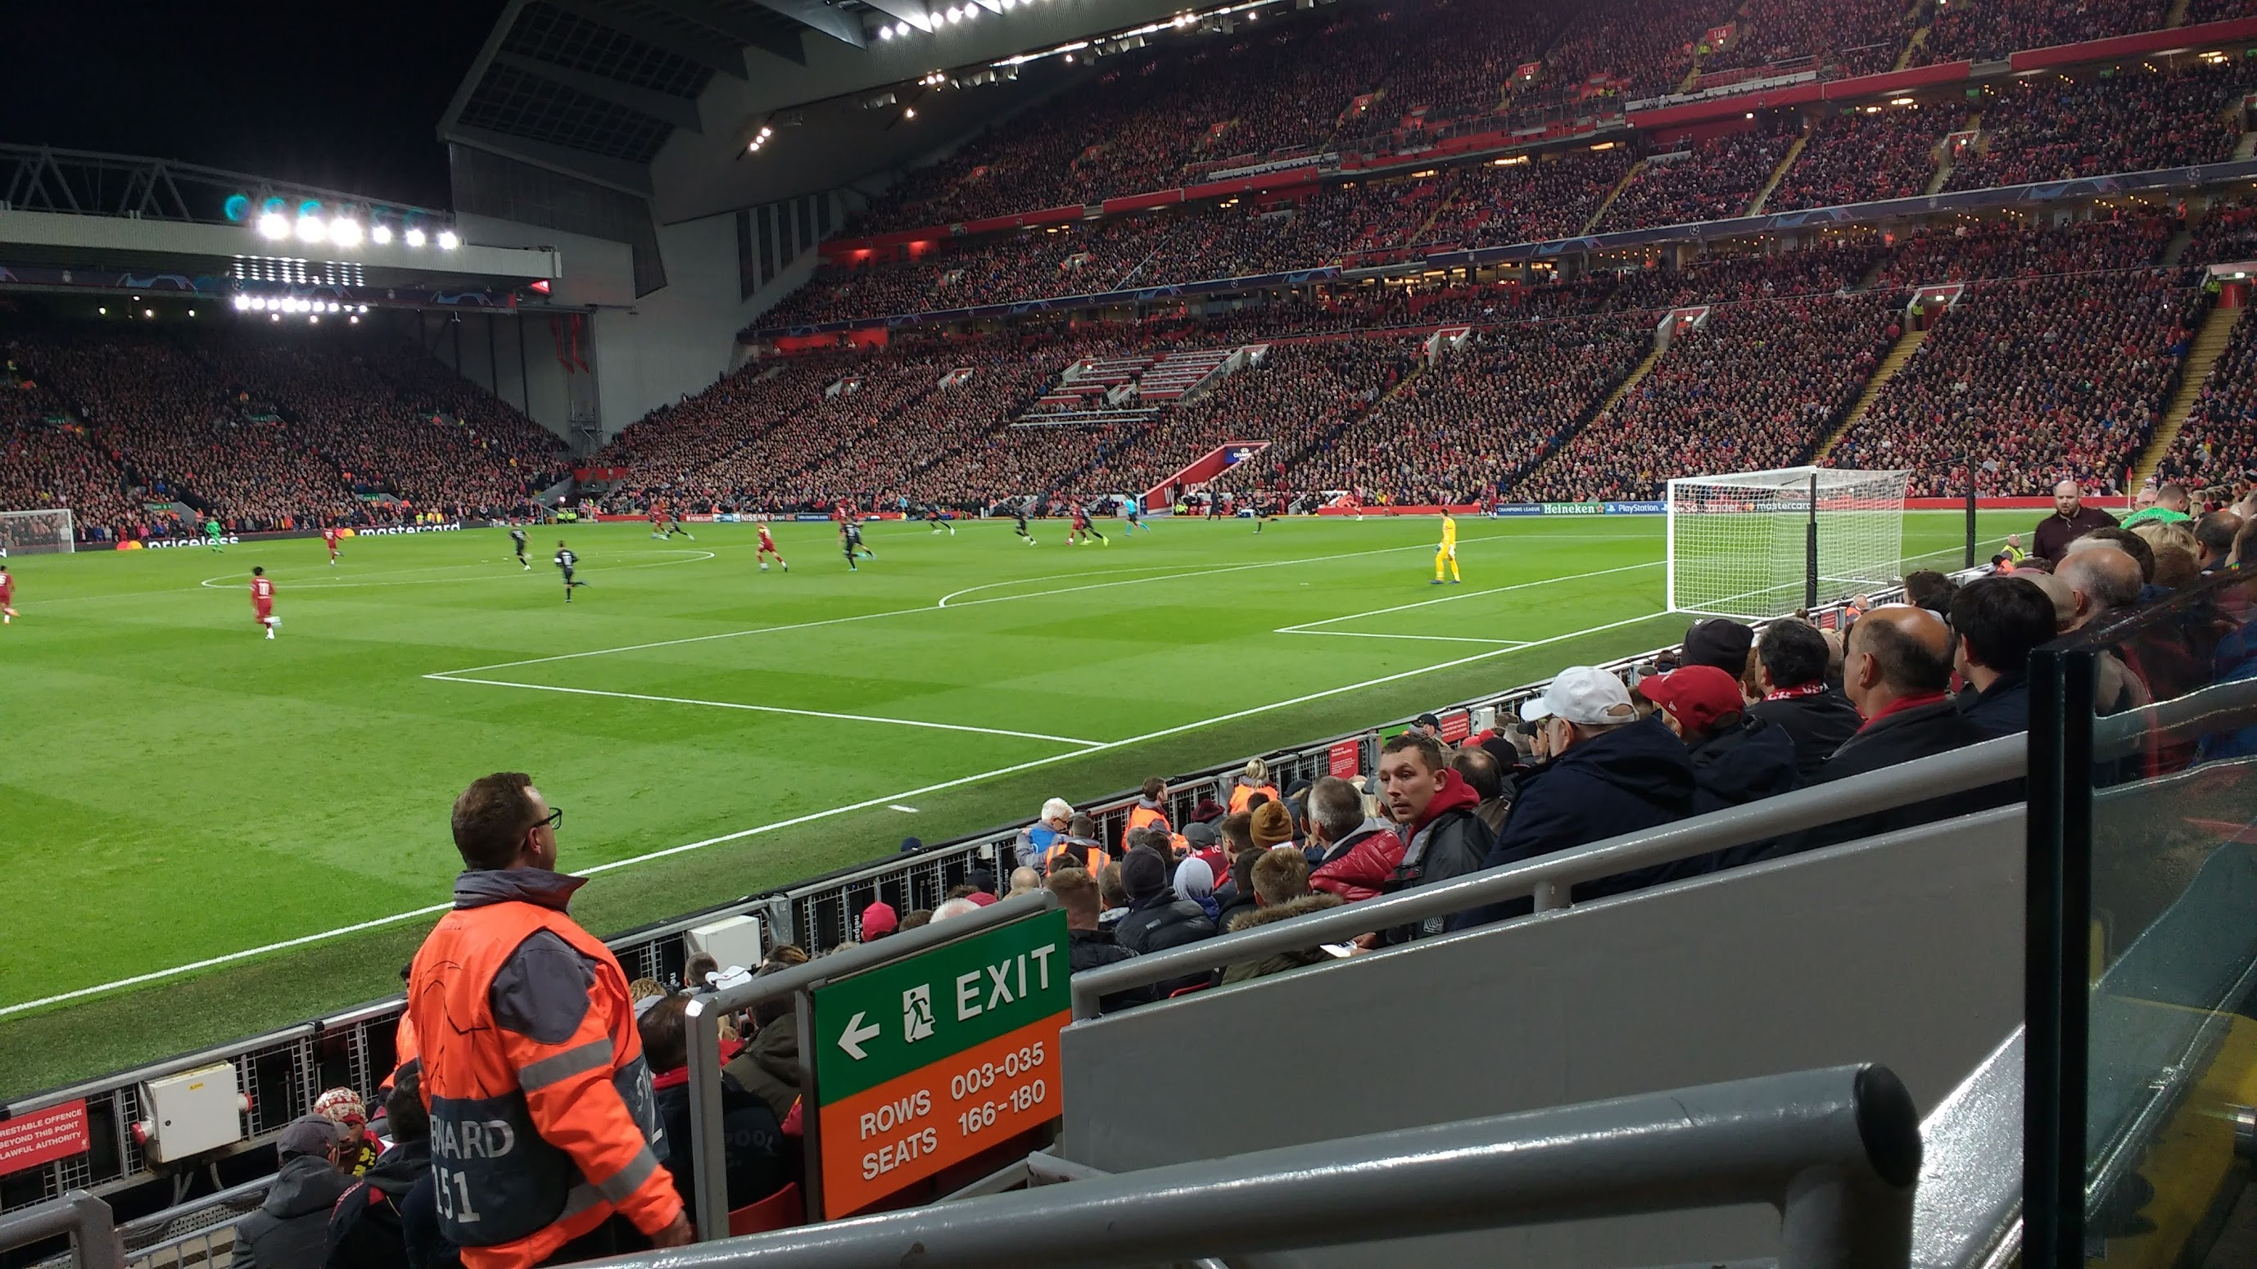
V L A R N O L D L L A O B L Y
R D M N D A Z E M O G N C M X
E M M I L N E R B A V A C O Q
H X J L G L E I V A N R H R W
A K A H N N I Y I V B E E E H
L N U E C C O U T I N H O N T
A Z L L M U Q L R D R C O O O
S L Y X U R O B E R T S O N T
A N E G D I R R U T S A I Y B
E S O X L T S G C I R M U L S
S U X S A O N Y L B R K I V T
D B T L N N Q A N I E R S Z I
G X J Q J H D V F R G U Q O R
K W I G I R O E S V G G T F I
E W G G W N S J R M A T I P N

Slide 13


Slide 14
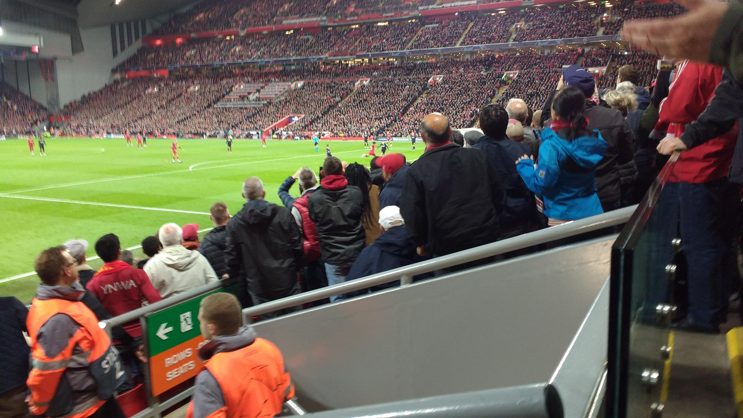
L H M A R S H S T R O N G Y C W O M U F
V F L R N S R E T A L S S O E O W L B B
O G C A L L A G H A N S E N R A B M N P
W K R A W K S W W A U W R R I E T A O W
L A W L E R S R E D K N A P P J M S T H
D K J E C N E M E L C B T S C A S E S E
F C G B A N N N I W E D T O N E E I N L
E A L B S M U I C A O E O A N I L A H A
N H I O F P O M R E V R M K P G C L O N
F S N R T T S D N E C C R S L R L O J W
I O D G C H S H N O M A E A E A Z P L F
D T S K Z L O S R L H L D D H H E K T W
S N A V E U O M M E L A C C E A G N U U
Y U Y Y G N A U P I I F M I F M A U T H
D H Z H Z C L G G S T M G C Q H M R H O
E P T I K S J I E H O H T Z M O S N H L
N O S N H O J Z M M W N S W O R R U B B
N O S I N E V Z P A L D R I D G E Y R L
E W D E J O N K Y N B G J Q D Y O L L Q
K A S U F K F A K I F W T T E L B A R M

Slide 15
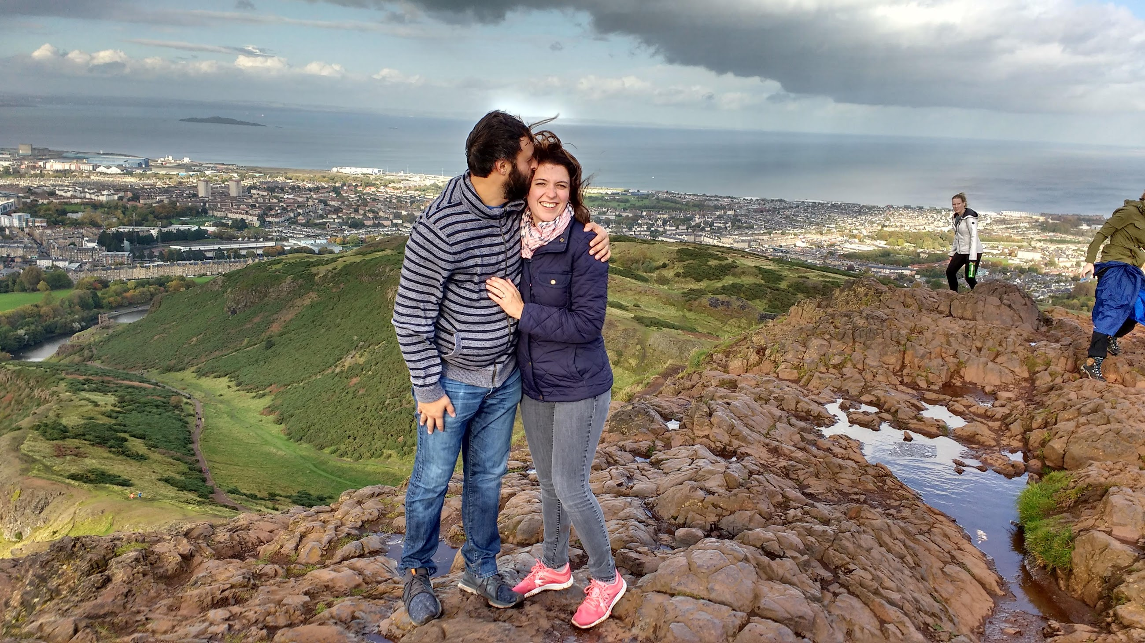
AGAIN AND ART AWHILE BONNIE COME DEAR DEEP DRY FAIR FARE GANG JUNE LASS LIFE LIKE LOVE LUVE MELODY MELT MILE NEWLY ONLY PLAYED RED ROCKS ROSE RUN SANDS SEAS SHALL SPRUNG STILL SUN SWEETLY TEN THAT THE THEE THOU THOUGH THOUSAND TILL TUNE WEEL WERE WHILE WILL
R O P U B T N G D S L F X B M
K W A K O S D N A S U O H T Y
M J Q Y S Y Y U T W T N V S M
N I A A L T T R A E D I H E X
D L L L I W O P D E Y A L P H
D E H E F S E S I T L O N L Y
K J R G E K P N H L D I E V O
W E C A U C N T U Y U E H A N
W O S N F O O A B J H V P W D
U B I G B R H H I T U N E W A
L I W Z I X Z T D W L K E P G
G T B A C W U L L I I E D T A
C S F P J V F E O L L O M K I
P I G M F F R C W F E L Q O N
O I S Y Q H M T E D S A U L C

Slide 16
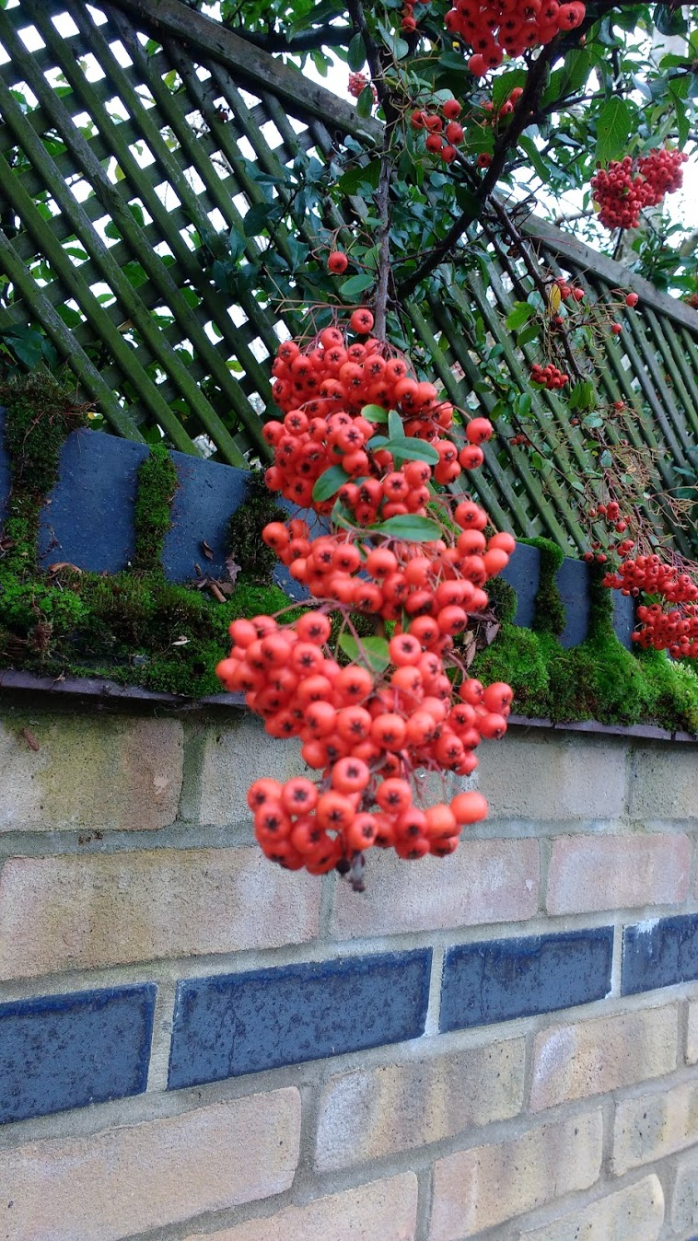
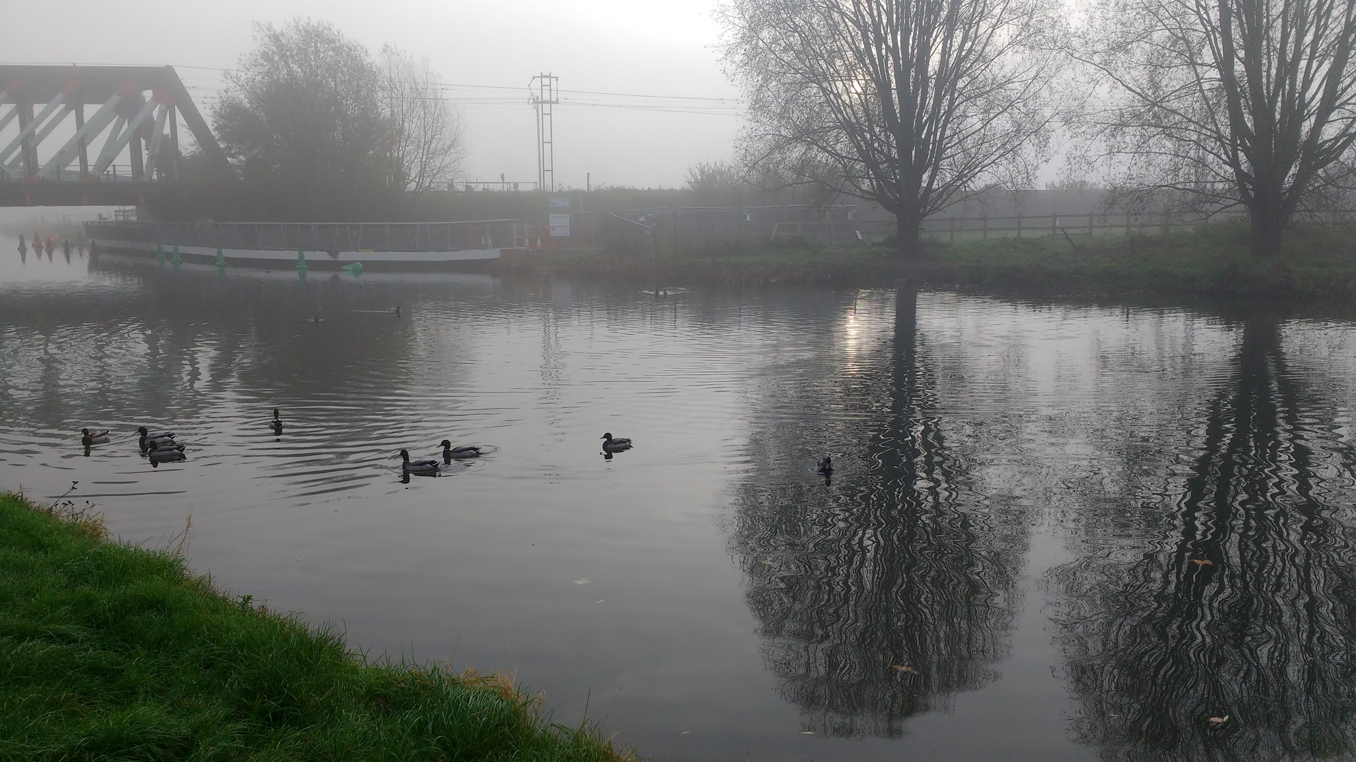
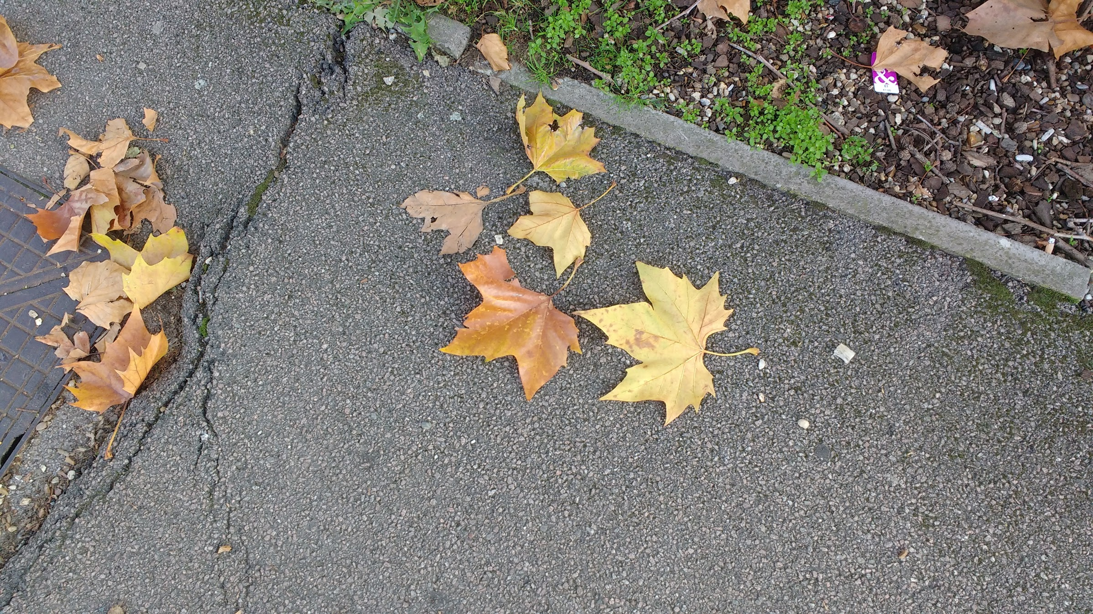
S X M X N J C O U T E S U G A
V T L N C S H U B G X T L M S
X S O I F R E J T R D A Q I Y
H M H U H M S O I T S N P D Z
C A S Y R A T V R T E D S S U
E L I Z A B E T H N R R R U I
T L H S Y R R E F A O E E M W
S F C W S R T I G O K W N M J
U R K I V E O O D A R S I E T
M Y D F I O N Y M G X T R R W
I E G T C P K Y V M E G A S C
G M R S K N A G O L B I M J E
P A E X I H P S Z P L Z H B Z
K T E D N Z N A I C E L B F F
N M N B D G Y Z A B N M Y D Y

Slide 17
O H W A L D O Q V J U L I A K P
J K E Q M O O D N O V E S S E J
A P R L L E W T T A R U H T R A
S Y N N E J V N K N G G E R A Y
O G D N O N N A H S D R M A T U
N N I T F A R K S U M A E S A S
O O B R F I C N A U R E M A D A
S S L M E G I I R K E S R A A N
L E I N A D R R N A M U I U H A
E V B M E L A E W N I V A G S C
N E X C J Y W G Y D R N D O I H
Z T M Y R L S T S R P B S M R A
S S U U Y C S R O E D J A A H L
J L S N Q W A A Z W A N L T C Z
K T T C K V W H K I M N A I D R
Z P I F E K A R L A S B O C A J

Slide 18
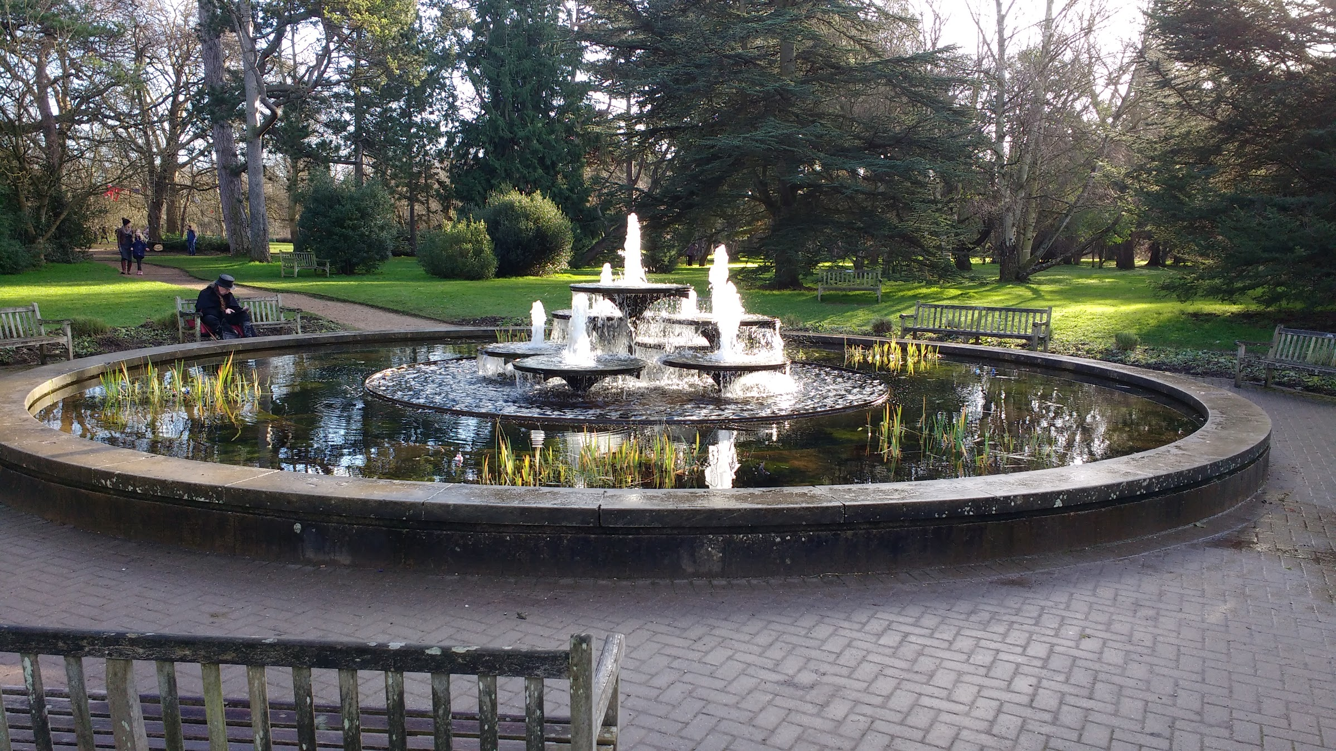
N A S J O H N M O N S O M N I F E R U M
P B Y U A E C A N I H C E V O L G X O F
U K M H H M R D L G G E T I H W U Y T K
R M U Y C T M A Y H R A P O R T A X U S
P R T P O A N G X T A E D W N Y C S E A
U E A E K I T A X S P D V A A D I A T U
R W R R C W R S R H E I I A E O N L E N
E O O I T B O C I A Y G A E P N O I E N
A L F C W E W A U D H I R A O A P X W A
N F R U O I M R W E B T W D R X P G S P
O E E M R D N I V M B A A R U U I O U O
H N P K M O L K S I U L C C E N N R E P
C O Y E W L Y H L I L I X C K V P D S P
N C D I O S C O R E A S P G A L E W O Y
I R I W O N B A B L A I O O E T P F R Y
C X Y L D A E D M J E P H E D R A B J B
N A S J O H N M O N S O M N I F E R U M
P B Y U A E C A N I H C E V O L G X O F
U K M H H M R D L G G E T I H W U Y T K
R M U Y C T M A Y H R A P O R T A X U S
P R T P O A N G X T A E D W N Y C S E A
U E A E K I T A X S P D V A A D I A T U
R W R R C W R S R H E I I A E O N L E N
E O O I T B O C I A Y G A E P N O I E N
A L F C W E W A U D H I R A O A P X W A
N F R U O I M R W E B T W D R X P G S P
O E E M R D N I V M B A A R U U I O U O
H N P K M O L K S I U L C C E N N R E P
C O Y E W L Y H L I L I X C K V P D S P
N C D I O S C O R E A S P G A L E W O Y
I R I W O N B A B L A I O O E T P F R Y
C X Y L D A E D M J E P H E D R A B J B

